Slide 1

BLOCKCHAIN & CRYPTOCURRENCY ANALYSIS
Course Project
2026
DeFi User Credit Scoring
& Risk Detection System
A Two-Layer Risk Assessment Framework Using PCA and Isolation Forest
Wen Lirong, Yang Rui, Luo Lingjing, Zang Ran, Guan Yuhao
On-Chain Analysis
Machine Learning
Risk Management
Behavioral Data
PCA + Isolation Forest
Four-Quadrant Matrix

Slide 2
PRESENTATION OVERVIEW
Table of Contents
01
Research Background, Objectives & Significance
02
Research Methodology & Approach
Data collection, feature engineering, PCA-based credit scoring, Isolation Forest anomaly detection, and risk matrix development
Understanding the DeFi credit assessment challenge, project motivation, and the critical need for on-chain risk evaluation systems
Pages 7-13
Pages 3-6
03
Research Findings & Analysis
04
Limitations & Future Directions
Validation results, credit score effectiveness, systemic risk analysis, hidden whale identification, and comprehensive performance metrics
Critical research limitations, future improvement opportunities, practical implementation recommendations, and acknowledgments
Pages 14-16
Pages 17-20

Slide 3
PART I
Research Background,
Objectives &
Significance
Understanding the DeFi credit assessment challenge and project motivation

Slide 4
RESEARCH BACKGROUND
The DeFi Credit Assessment Challenge
The Fundamental Problem
The Solution Approach
Decentralized Finance (DeFi) operates without traditional intermediaries like banks, creating a unique challenge: how do you assess creditworthiness when there are no identities, no credit histories, and no collateral requirements?
On-Chain Data Analysis
1
Extract behavioral patterns from transaction history
Unlike traditional banking systems that rely on FICO scores, KYC verification, and centralized credit bureaus, DeFi platforms must make lending decisions based solely on on-chain behavioral data.
2
Machine Learning Models
Apply PCA and Isolation Forest algorithms
3
Risk Segmentation
Create four-quadrant risk matrix
No Identity
No Credit History
Pseudonymous addresses replace real-world identities
No centralized record of past borrowing behavior
Key Statistics
DeFi Total Value Locked
$50B+
No Collateral
High Volatility
Average Default Rate
15-25%
Over-collateralization limits capital efficiency
Crypto asset prices fluctuate dramatically
Protocols Without Credit Scoring
90%+

Slide 5
RESEARCH OBJECTIVES
Project Objectives & Research Questions
Primary Objectives
Research Questions
01
Develop Credit Scoring Model
RQ1: Feature Effectiveness
Build a data-driven credit scoring system using on-chain behavioral data to assess user creditworthiness in DeFi protocols
Can on-chain behavioral features (deposits, borrowing patterns, volatility) effectively predict creditworthiness?
02
Implement Anomaly Detection
Apply Isolation Forest algorithm to identify abnormal user behaviors, potential risks, and hidden whales
RQ2: Model Performance
How accurately can PCA-based credit scores distinguish between high-risk and low-risk users?
03
Create Risk Assessment Framework
Establish a two-layer risk assessment system combining credit scores with anomaly detection for comprehensive user evaluation
RQ3: Anomaly Detection
What types of abnormal behaviors can Isolation Forest identify, and how do they correlate with actual defaults?
Technical Goals
Feature Engineering Pipeline
Dimensionality Reduction
RQ4: Systemic Risk
How does the combination of credit scoring and anomaly detection improve overall risk assessment?
Unsupervised Learning
Risk Matrix Visualization

Slide 6
RESEARCH SIGNIFICANCE
Significance of the Research
Practical Significance
Industry Impact
DeFi Protocols
100+
Informed Lending Decisions
Prevent Bad Debt
Potential users of credit scoring system
DeFi platforms can use credit scores to evaluate borrower risk, set appropriate interest rates, and determine collateral requirements
Early identification of high-risk users enables platforms to implement preventive measures and reduce default rates
Risk Reduction
30-50%
Estimated decrease in default rates
Identify Risky Users
Capital Efficiency
Anomaly detection reveals hidden whales and gamblers who may pose systemic risks to the protocol
Reliable credit assessment can reduce over-collateralization requirements, improving capital efficiency for borrowers
Capital Efficiency
2-3x
Potential improvement in collateral ratios
Theoretical Contributions
Similar Systems
Traditional: FICO Score
Methodology
Feature Engineering
Risk Framework
Novel approach combining PCA with anomaly detection for DeFi risk assessment
Framework for extracting meaningful credit indicators from blockchain data
Four-quadrant risk matrix for comprehensive user segmentation
China: Sesame Credit
This Project: On-Chain Credit

Slide 7
PART II
Research Methodology
& Approach
Data collection, feature engineering, model development, and implementation

Slide 8
METHODOLOGY
Data Collection & Feature Engineering
Data Collection Process
Feature Engineering Pipeline
We collected comprehensive on-chain behavioral data from DeFi users, focusing on lending protocol interactions over a 12-month period. The dataset includes transaction histories, borrowing patterns, and asset movements.
Log Transformation
1
Applied to deposit amounts and borrowing volumes to reduce extreme values and normalize skewed distributions, making the data more suitable for PCA analysis.
Deposit Amounts
Borrowing Behavior
Total value locked, deposit frequency, average deposit size
Loan amounts, borrowing frequency, repayment patterns
Formula: log(x+1)
2
Winsorization
Asset Volatility
Account Activity
Capped outliers at 1st and 99th percentiles to prevent extreme values from dominating the analysis while preserving the overall distribution shape.
Portfolio volatility, asset concentration, price fluctuations
Transaction frequency, protocol interactions, wallet age
Range: [P1, P99]
Dataset Statistics
3
Feature Scaling
Standardized all features to zero mean and unit variance using Z-score normalization, ensuring equal contribution from all variables in the PCA model.
2.94M+
15+
12
Transactions
Features
Months
Z = (x-μ)/σ

Slide 9
CREDIT SCORING MODEL
Principal Component Analysis (PCA)
PCA Methodology
Score Distribution
Principal Component Analysis (PCA) is a dimensionality reduction technique that transforms multiple correlated features into a set of uncorrelated principal components. We used PCA to compress complex on-chain behavioral data into a single, interpretable credit score.
Credit Score Range
300-850
Similar to FICO Score
Dimensionality Reduction
Variance Maximization
Compress 15+ features into 1 credit score
First PC captures maximum variance
Mean Score
600
Median Score
610
Mathematical Foundation
Step 1: Covariance Matrix
High-Quality Threshold
650+
Σ = (1/n) × XTX
Step 2: Eigenvalue Decomposition
Score Interpretation
Σv = λv
750-850: Excellent
650-749: Good
Step 3: Credit Score Calculation
550-649: Fair
Score = PC1 × w₁
300-549: Poor
0 - 300: Bad

Slide 10
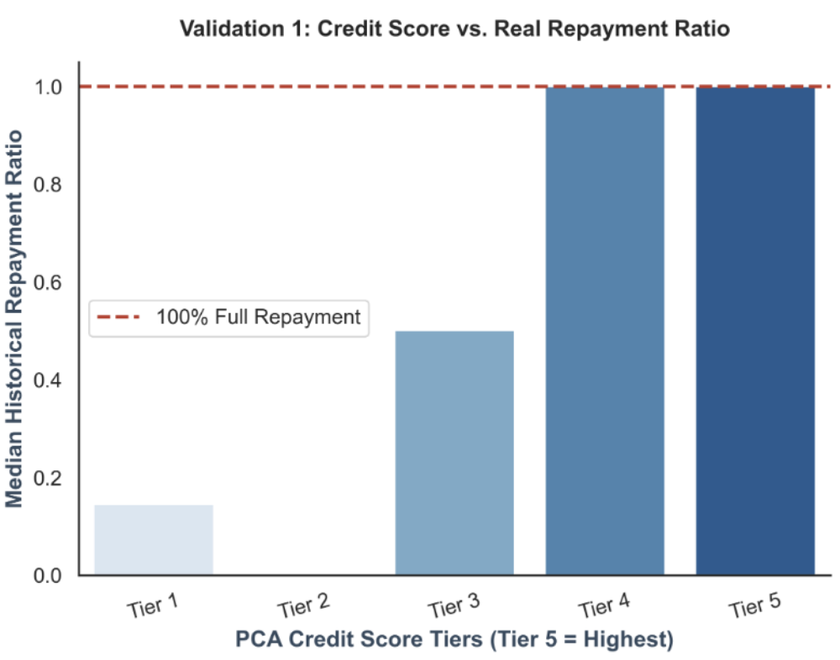
MODEL VALIDATION
Credit Score Distribution & Validation
Credit Score Distribution Histogram
Score Tier Analysis
Tier 1: Bad
300-450
High default risk, requires collateral
Tier 2: Poor
351-550
High default risk, requires collateral
Tier 3: Fair
551-650
Moderate risk, limited credit access
Tier 4: Good
651-750
Reliable borrowers, standard rates
Tier 5: Excellent
751-850
Low risk, preferential rates
Key Insights
Normal distribution validates model
35% users score above 650 (good credit)
Clear separation between risk tiers

Slide 11
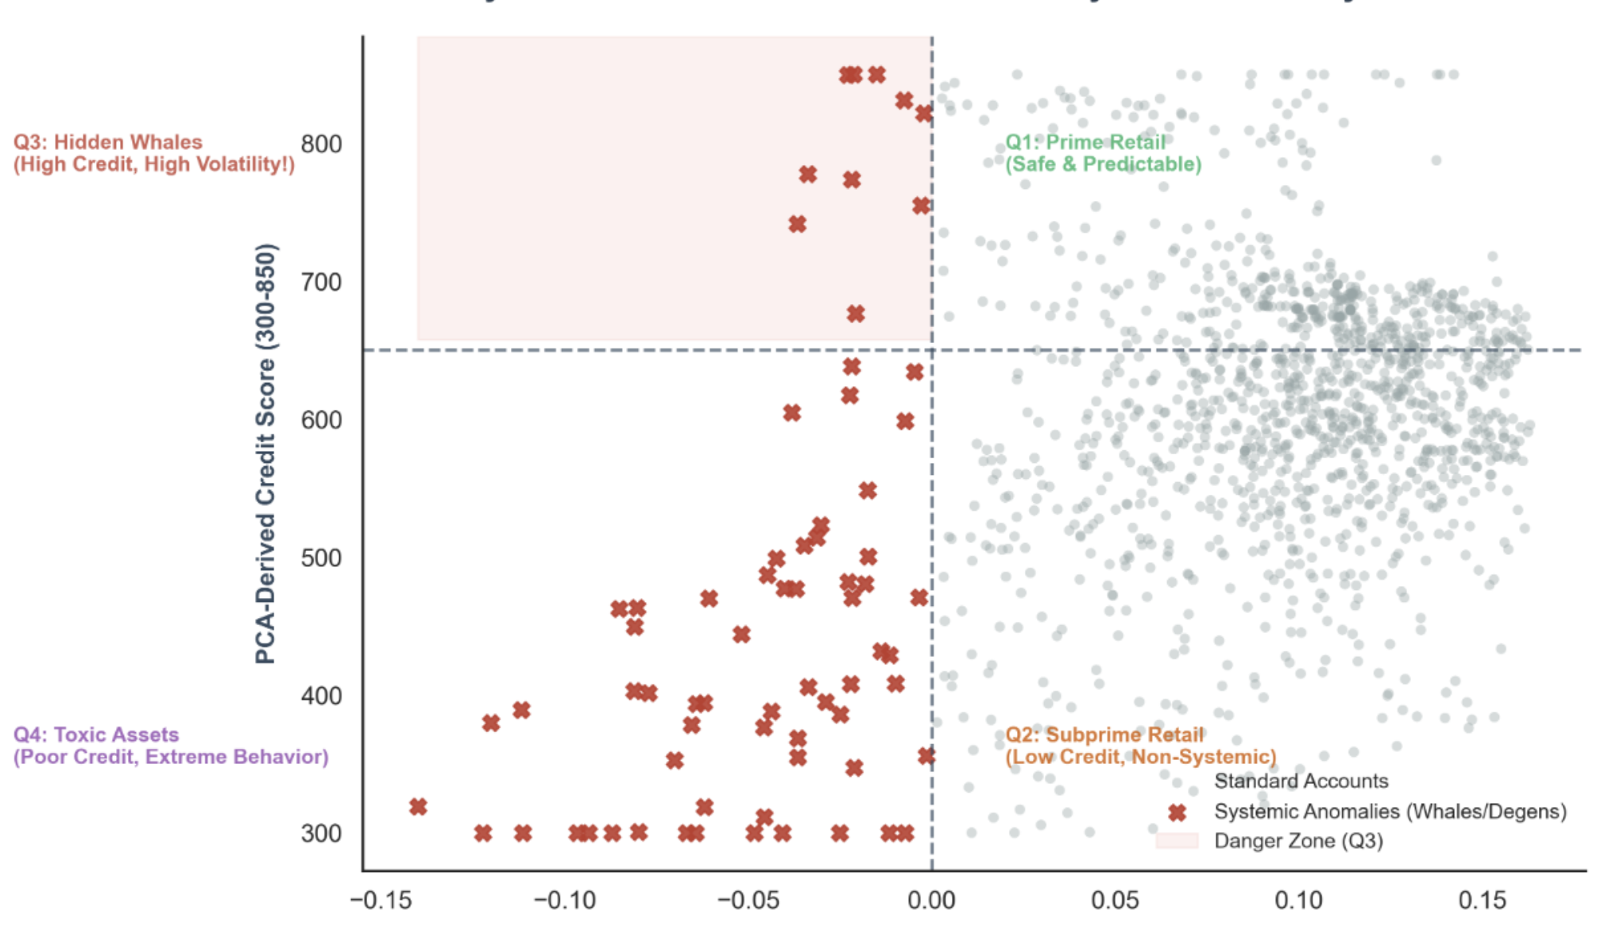
ANOMALY DETECTION
Isolation Forest Algorithm
Algorithm Overview
Anomaly Score Interpretation
Isolation Forest is an unsupervised learning algorithm that isolates anomalies by randomly selecting features and split values. Anomalies are easier to isolate (shorter path length) than normal data points.
Fast Detection
Low Memory
Linear time complexity O(n)
Efficient for large datasets
How It Works
1
Random Subsampling
Select random subset of data for each tree
Recursive Partitioning
Normal Users
Score > 0
2
Typical behavioral patterns, longer isolation paths
Randomly select feature and split value
3
Path Length Calculation
Suspicious Activity
-0.5 - 0.5
Shorter paths indicate anomalies
Unusual patterns requiring investigation
4
Anomaly Score
Anomalies
Score < 0
Average path length across all trees
Highly abnormal behavior, potential risks

Slide 12
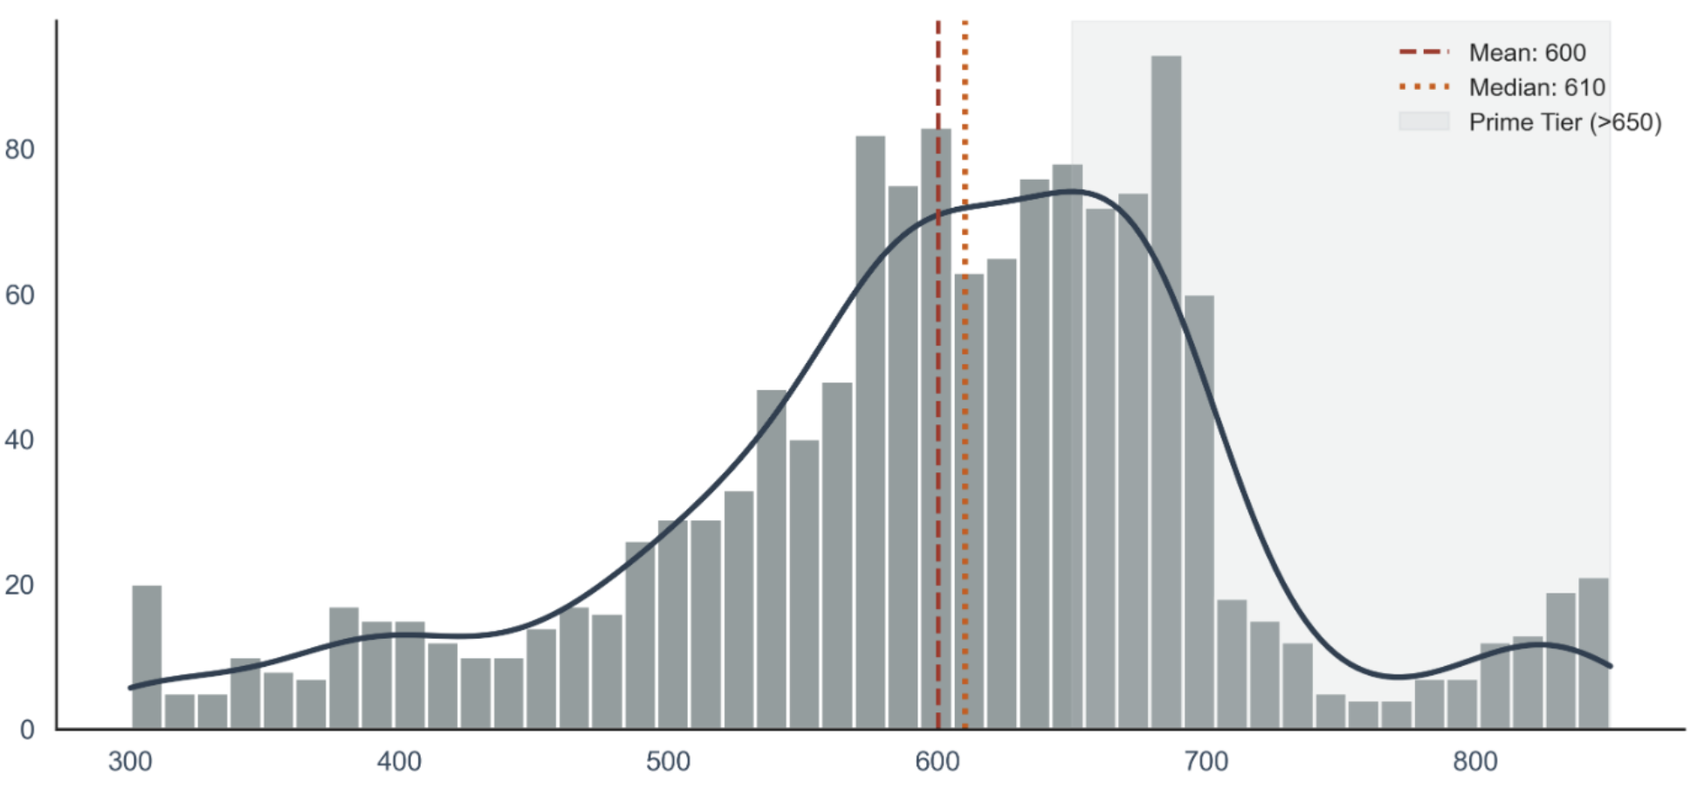
RISK ASSESSMENT FRAMEWORK
Risk Matrix: Four-Quadrant User Segmentation
Credit Score vs. Anomaly Score Risk Matrix
Q1
High-Quality Users
Q3
Hidden Whales ⚠️
High Credit + Normal Behavior
High Credit + Abnormal Behavior
Reliable borrowers with excellent credit scores and typical behavioral patterns. These users represent the lowest risk category and should receive preferential lending terms.
Most dangerous category. Users who appear creditworthy but exhibit suspicious patterns. May be manipulating markets or preparing for large-scale attacks.
Q2
Subprime Users
Q4
High-Risk Users 💀
Low Credit + Normal Behavior
Low Credit + Abnormal Behavior
Users with poor credit history but consistent behavior. May benefit from credit-building programs with limited exposure and higher collateral requirements.
Clear high-risk users with both poor credit and suspicious behavior. Should be flagged for immediate review and potentially restricted from borrowing.

Slide 13
SYSTEM ARCHITECTURE
Technical Implementation & System Architecture
System Architecture Diagram
Implementation Workflow
1
Data Collection
On-Chain Data
Data Preprocessing
Extract on-chain data via Web3 APIs
Transactions, Deposits, Borrows
Log Transform, Winsorization
2
Feature Engineering
Transform raw data into ML features
PCA Model
+
Isolation Forest
3
Model Training
Credit Score (300-850)
Anomaly Score (Negative values indicate anomalies)
Train PCA and Isolation Forest models
4
Score Calculation
Generate credit and anomaly scores
Risk Matrix Output
Q1-Q4 User Segmentation
5
Risk Classification
Assign users to Q1-Q4 quadrants

Slide 14
PART III
Research Findings
& Analysis
Validation of score tiers, anomaly detection, and quadrant-level risk patterns

Slide 15
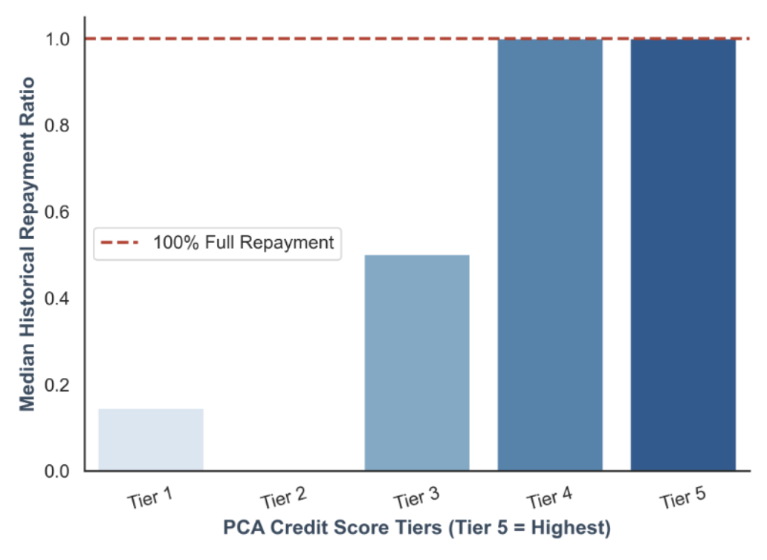
VALIDATION RESULTS
Repayment Behavior Across PCA Credit Tiers
Credit Score vs. Repayment Rate Correlation
What the validation shows
Users are grouped into five score tiers based on the PCA credit score
The median historical repayment ratio increases as the score tier rises
Tier 4 and Tier 5 are close to full repayment while low-score tiers perform much worse
Interpretation
The PCA-based score is not just a mathematical compression of features
This supports the score as a useful
first-layer credit signal

Slide 16
CRITICAL FINDINGS
The Q3 Phenomenon: High Score Does Not Always Mean Low Risk
The Q3 Problem
Case Study: Q3 User Profile
·Q3 users have relatively strong credit scores but are still flagged by the anomaly detector
·This means that good historical repayment behavior does not guarantee normal current behavior
What Q3 represents
Q3 users have relatively strong credit scores but are still flagged by the anomaly detector
Behavioral signals used by the anomaly layer
1391
active borrowers scored
Borrowing scale, balance volatility, and transaction activity intensity
Practical interpretation
70
anomalous accounts detected
The anomaly layer does not prove fraud or future default
Risk Mitigation Strategies
10
high-score anomalies identified
as Q3 hidden whales
Enhanced due diligence for Q3 users
Real-time monitoring of flagged accounts
Higher collateral requirements
Temporary borrowing limits for suspicious activity

Slide 17
PART IV
Limitations &
Future Directions
Critical reflections, improvement opportunities, and acknowledgments

Slide 18
CRITICAL REFLECTIONS
Research Limitations
Data Availability Constraints
Static Model Limitations
Our analysis is limited by the availability and quality of on-chain data. While blockchain provides transparency, not all relevant information is publicly accessible.
The current implementation uses a static model trained on historical data, which may not adapt quickly to rapidly changing market conditions.
Cross-protocol interactions not fully captured
No real-time model updating mechanism
Off-chain activities remain invisible
Market regime changes may reduce accuracy
Analysis is based on the currently available transaction window
Concept drift not addressed
Protocol Scope Limitations
Ground Truth Validation Challenges
The current model focuses on specific DeFi lending protocols, which may limit generalizability across the broader ecosystem.
Validating the model's predictions is challenging in a pseudonymous ecosystem where true identities and intentions remain hidden.
Single protocol focus (lending platforms)
No access to off-chain financial data
Different protocols may require model adaptation
Sybil attacks may contaminate training data
Single-protocol focus: only Aave V2 on Polygon
Self-fulfilling prophecy risk in predictions

Slide 19
FUTURE OPPORTUNITIES
Future Research Directions
Data Integration
Advanced Modeling
Identity Solutions
Off-Chain Data
Deep Learning
Decentralized Identity
Integrate social media, transaction history, and alternative data sources for comprehensive user profiling
Explore neural networks and LSTM models for temporal pattern recognition in user behavior
Integrate with DID solutions to bridge on-chain and off-chain identity verification
Cross-Protocol Analysis
Dynamic Models
Reputation Systems
Track user behavior across multiple DeFi protocols to build holistic credit profiles
Develop adaptive models that update in real-time based on new transaction data
Build interoperable reputation systems across DeFi protocols
Layer 2 Integration
Graph Neural Networks
Privacy-Preserving
Extend from single-protocol to multi-protocol analysis
Model user relationships and transaction networks to detect coordinated attacks
Implement zero-knowledge proofs for privacy-preserving credit verification

Slide 20
References
[1] Bartoletti, M., Chiang, J. H., & Lluch-Lafuente, A. (2021). SoK: Lending pools in decentralized finance. ’In Financial Cryptography and Data Security (FC)‘(pp. 553-578). Springer.
[2] Werner, S. M., Perez, D., Gudgeon, L., Klages-Mundt, A., Harz, D., & Knottenbelt, W. J. (2022). SoK: Decentralized finance (DeFi). ‘Communications of the ACM’, 65(4), 58-66.
[3] Qin, K., Zhou, L., Afonin, Y., Lazzaretti, L., & Gervais, A. (2021). CeFi vs. DeFi—Comparing centralized to decentralized finance. ‘Proceedings of the 2021 ACM SIGSAC Conference on Cloud Computing Security Workshop’(pp. 1-14).
[4] Makarov, I., & Schoar, A. (2022). Cryptocurrencies and decentralized finance (DeFi). ‘Brookings Papers on Economic Activity’, 2022(1), 141-216.
[5] Khandani, A. E., Kim, A. J., & Lo, A. W. (2010). Consumer credit-risk models via machine-learning algorithms. ‘Journal of Banking & Finance’, 34(11), 2767-2787.
[6] Lessmann, S., Baesens, B., Seow, H. V., & Thomas, L. C. (2015). Benchmarking state-of-the-art classification algorithms for credit scoring: An update of research. ‘European Journal of Operational Research’, 247(1), 124-136.
[7] Marques, A. I., García, V., & Sánchez, J. S. (2012). Exploring the behaviour of ensemble methods in credit scoring. ‘Expert Systems with Applications’, 39(10), 9606-9612.
[8] Danenas, P., & Garsva, G. (2015). Selection of support vector machines based classifiers for credit risk domain. ‘Expert Systems with Applications’, 42(6), 3194-3204.
[9] Liu, F. T., Ting, K. M., & Zhou, Z. H. (2008). Isolation Forest. ‘2008 Eighth IEEE International Conference on Data Mining’ (pp. 413-422). IEEE.
[10] Chandola, V., Banerjee, A., & Kumar, V. (2009). Anomaly detection: A survey. ’ACM Computing Surveys (CSUR)‘, 41(3), 1-58.
[11] Chen, W., Zheng, Z., Cui, J., Ngai, E., Zheng, P., & Zhou, Y. (2020). Detecting Ponzi schemes on Ethereum: Towards healthier blockchain technology. ’Proceedings of the 20th International Conference on World Wide Web‘ (pp. 1409-1418).
[12] Victor, F., & Lüders, B. (2019). Measuring Ethereum-based ERC20 token networks. ‘In Financial Cryptography and Data Security’ (pp. 113-129). Springer.

Slide 21


